Slide 1
Distributed concurrency control
Dario Della Monica
These slides are a modified version of the slides provided with the book
Özsu and Valduriez, Principles of Distributed Database Systems (3rd Ed.), 2011
The original version of the slides is available at: extras.springer.com

Slide 2
Outline (distributed DB)
Introduction (Ch. 1) ⋆
Distributed Database Design (Ch. 3) ⋆
Distributed Query Processing (Ch. 6-8) ⋆
Distributed Transaction Management (Ch. 10-12) ⋆
Introduction to transaction management (Ch. 10) ⋆
Distributed Concurrency Control (Ch. 11) ⋆
Distributed DBMS Reliability (Ch. 12) ⋆
⋆ Özsu and Valduriez, Principles of Distributed Database Systems (3rd Ed.), 2011

Slide 3
Outline (today)
Distributed Concurrency Control (Ch. 11) ⋆
Serializability Theory
Formalization/Abstraction of Transactions
Formalization/Abstraction of Concurrent Transactions (Histories)
Serial Histories
Locking-based
(strict) 2-phase Locking (2PL)
Deadlock management
⋆ Özsu and Valduriez, Principles of Distributed Database Systems (3rd Ed.), 2011

Slide 4
Concurrency Control
The problem of synchronizing concurrent transactions such that the consistency of the database is maintained while, at the same time, maximum degree of concurrency is achieved
This has to do with C(onsistency) and I(solation) from the ACID properties
Consistency: assuming that each transaction is internally consistent (no integrity constraint violations) it is obtained by guaranteeing the right level of isolation (serializability)
Isolation: isolating transactions from one another in terms of their effects on the DB. More precisely, in terms of the effect on the DB of intermediate operations (before commit)
Tradeoff between isolation and parallel execution (concurrency)
Assumptions
System is fully reliable (no failures) – we deal with reliability in Ch. 12⋆
No data replication – discussion on data replication is in Ch. 13⋆ (we do not cover this chapter)
Possible anomalies
Lost updates
The effects of some transactions are not reflected on the database
Inconsistent retrievals
A transaction, if it reads the same data item more than once, should always read the same value
⋆ Özsu and Valduriez, Principles of Distributed Database Systems (3rd Ed.), 2011

Slide 5
POSET’s to Model Transactions
We treat a transaction as a POSET (aka partially ordered set, partial order)
POSET’s are pairs < ∑ , ≺ > where
∑ is a set (domain)
≺ is a binary relation over ∑ (≺ ⊆ ∑ x ∑) that is
irreflexive (not a ≺ a, for all a)
asymmetric (a ≺ b implies not b ≺ a, for all a,b)
transitive (a ≺ b and b ≺ c implies a ≺ c, for all a,b,c)
Operations are
DB operations (read or write): R(x), W(x) (where x is a data entity, e.g., a tuple) or
termination conditions (abort or commit): A, C
A transaction is modeled as a partially ordered set of operations containing exactly one termination condition

Slide 6
Formalization/Abstraction of Transactions
A transition is a POSET T = < ∑ , ≺ > where
∑ is finite: it is the set of operations of T
O is the set of DB operations in ∑ (operation that are not termination conditions)
i.e., elements of O are of the kind R(x), W(x) where x is a data entity
Thus, ∑ = O ⋃ { N }, where N ∈ { A, C } (exactly 1 termination condition)
2 DB operations (elements of O) conflict iff they act on the same data entity x and one of them is a write W operation
W(x), R(x) are in conflict, W(x), W(x) are in conflict
W(x), R(y) are NOT in conflict, W(x), W(y) are NOT in conflict, R(x), R(x) are NOT in conflict
NOTICE: it is possible to have 2 distinct W(x) operations
We assume implicit indices to make every operation unique
Operations are atomic (indivisible units)
≺ is s.t.
order of conflicting operation is specified
for all o₁, o₂ ∈ O: if o₁ and o₂ conflict, then either o₁ ≺ o₂ or o₂ ≺ o₁
all DB operations precede the unique termination condition
for all o ∈ O: o ≺ N

Slide 7
Formalization/Abstraction of Transactions – cont’d
POSET’s are DAG (directed acyclic graphs)
We represent a transaction either way (as a POSET or as a DAG)
The order of 2 conflicting operations is important and MUST be specified
it specify the execution order between the 2 operations
Operations that are not related can be executed in parallel
A transaction might force other precedence order relations besides the ones between conflicting operations
These depend on application semantics
Transaction T: Read(x) Read(y) x ←x + y Write(x) Commit
POSET representation of T:
∑= {R(x), R(y), W(x), C}
≺ = { ( R(x) , W(x) ), ( R(y) , W(x) ), ( W(x) , C ), ( R(x) , C ), ( R(y) , C ) }
POSET representation abstracts away application (non-DB) operations (e.g., x ←x + y)

Slide 8
DAG Representation
Let T = { R(x) ≺ W(x) , R(y) ≺ W(x) , W(x) ≺ C , R(x) ≺ C , R(y) ≺ C } (compact representation of a POSET)
Corresponding DAG representation:
R(x)
W(x)
C
R(y)
Let T = { R(x) ≺ W(x) , R(y) ≺ W(x) , W(x) ≺ C , R(x) ≺ C , R(y) ≺ C }
R(x)
W(x)
Order of R(y) and W(x) is irrelevant
(order of 2 read operations is always irrelevant)
C
R(y)
Transactions are DAG’s (directed acyclic graphs)

Slide 9
Transactions as Executions
There is at least one (possibly several), at least one, linear orders (aka total orders) compatible with (i.e., extending) any given partial order
Each of them is a possible execution of the transaction
Therefore, a transaction that is a linear order is a transaction execution
R(x)
R(x) ≺ R(y) ≺ W(x) ≺ C
R(y) ≺ R(x) ≺ W(x) ≺ C
W(x)
C
R(y)

Slide 10
From Transactions to Histories
Informal definition: A history is defined over a set of transactions and specifies possible interleaved executions of transactions in such set
The formalization of transaction as POSET’s can be extended to sets of transactions to define histories
Formal definition:
Extend the notion of conflicting operations to pairs of operations O_{i} , O_{j} belonging to different transactions
Given a set T = { T₁ , …, T_{n} } of transactions
(where T_{i} = < ∑_{i} , ≺_{i} > for all i – we assume ∑_{i} ∩ ∑_{j} = Ø for all i ≠ j)
A history H over T is a pair H = < ∑ , ≺ > where
∑ = ⋃_{Ti ∈ T} ∑_{I} is a finite set of read/write operations plus one termination condition (C or A) for each transaction)
≺ ⊇ ⋃_{Ti ∈ T} ≺_{i} is a partial order that extends ≺_{i} by including precedence constraints for conflicting operations belonging to different transactions (and, possibly, more precedence constraints for pairs of operations belonging to different transactions)
Still, the order of 2 conflicting operations is important and MUST be specified. Therefore
for all o_{i} ∈ ∑_{i} and all o_{j} ∈ ∑_{j} (i ≠ j): if o_{i} and o_{j} conflict, then either o_{i} ≺ o_{j} or o_{j} ≺ o_{i}
A history that is a linear order is a concurrent transaction execution
In the book ⋆ the term complete history is used for what we call here history
because they use histories to refer to prefixes of histories (partial histories)
⋆ Özsu and Valduriez, Principles of Distributed Database Systems (3rd Ed.), 2011

Slide 11
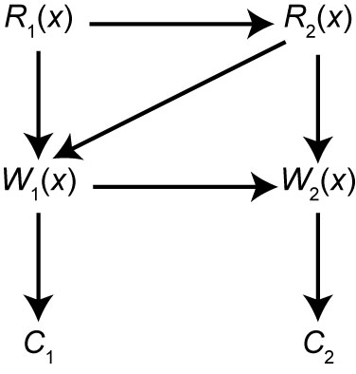
History – Example
T₁: R(x) T₂: R(x)
x ← x + 1 x ← x + 1
W (x) W(x)
C C
A history over T = { T₁ , T₂ } is the partial order:
H = { R₁(x) ≺ R₂(x) ≺ W₁(x) ≺ C₁ ≺ W₂(x) ≺ C₂ }
H is actually a linear order, so it is a concurrent execution of transactions T₁ and T₂

Slide 12
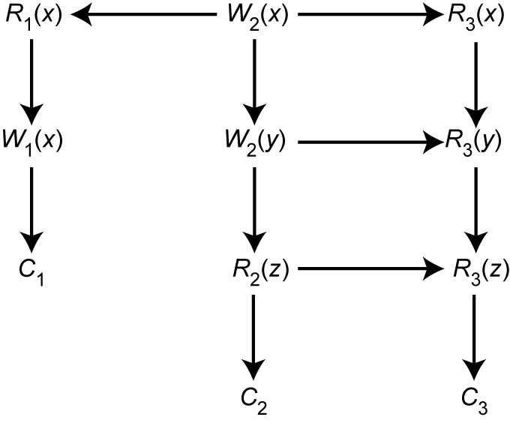
Serial History
A serial history (or serial execution of concurrent transactions or serial execution) is a concurrent transaction execution where operations of different transaction do not interleave
A serial history defines a linear order over transactions, too (serialization order)
T₁: Read(x) T₂: Write(x) T₃: Read(x)
Write(x) Write(y) Read(y)
Commit Read(z) Read(z)
Commit Commit
A serial history over T = { T₁ , T₂ } compatible with H is the linear order (we omit the termination conditions C_{i}):
H’ = { W₂(x) ≺ W₂(y) ≺ R₂(z) ≺ R₁(x) ≺ W₁(x) ≺ R₃(x) ≺ R₃(y) ≺ R₃(z) }
T₂
≺
T₁
≺
T₃
A history H over T = { T₁ , T₂ , T₃ }
A serial history preserves DB consistency (as transactions, when executed singularly, brings DB from a consistent state to another consistent state)

Slide 13
Conflict equivalence
Definition. Two histories over the same set of transactions are conflict equivalent (or, simply equivalent) iff they agree on the execution order of the conflicting operations
H₁ = < ∑₁ , ≺₁ > and H₂ = < ∑₂ , ≺₂ > with O and O’ conflicting operations
then O ≺₁ O’ if and only if O ≺₂ O’
(we are ignoring abort transaction to keep definition simpler)
H’ = { W₂(x) ≺_{H’} W₂(y) ≺_{H’} R₂(z) ≺_{H’} R₁(x) ≺_{H’} W₁(x) ≺_{H’} R₃(x) ≺_{H’} R₃(y) ≺_{H’} R₃(z) }
is NOT equivalent to H₁ = { W₂(x) ≺_{H1} R₁(x) ≺_{H1} R₃(x) ≺_{H1} W₁(x) ≺_{H1} R₃(y) ≺_{H1} R₃(z) ≺_{H1} W₂(y) ≺_{H1} R₂(z) }
because W₁(x) ≺_{H’} R₃(x) in H’ but R₃(x) ≺_{H1} W₁(x) in H₁
is equivalent to H₂ = { W₂(x) ≺_{H2} R₁(x) ≺_{H2} W₁(x) ≺_{H2} R₃(x) ≺_{H2} W₂(y) ≺_{H2} R₃(y) ≺_{H2} R₂(z) ≺_{H2} R₃(z) }
(actually H’, H₁, H₂ are all concurrent transaction executions)
Definition. A history is serializable iff it is equivalent to a serial execution
Therefore, H₂ is serializable (because H₂ is equivalent to H’, which is a serial history)
Primary function of a concurrency controller is to produce a serializable history over the set of pending transactions

Slide 14
Serializability in Distributed DBMS
Somewhat more involved. Two histories have to be considered:
local histories: histories over sets of transactions at the same site
global history: union of local histories
For global transactions (i.e., global history) to be serializable, two conditions are necessary:
Each local history should be serializable
Identical local serialization order
⋆ Özsu and Valduriez, Principles of Distributed Database Systems (3rd Ed.), 2011

Slide 15
Example
T₁ transfers 100 € from bank account x to y
T₂ reads balance of x and y
x is stored at site s₁
y is stored at site s₂
site s₁: T_{1,s1} = { R₁(x) ≺ W₁(x) } T_{2, s1} = { R₂(x) }
site s₂: T_{1, s2} = { R₁(y) ≺ W₁(y) } T_{2, s2} = { R₂(y) }
Local history at site s₁ : H_{s1} = { R₁(x) ≺ W₁(x) ≺ R₂(x) }
H_{s1} is serial with serialization order T₁ ≺ T₂
Local history at site s₂ : H_{s2} = { R₁(y) ≺ W₁(y) , R₂(y) ≺ W₁(y) }
H_{s2} is locally serializable: R₂(y) ≺ R₁(y) ≺ W₁(y)
but not globally (serialization order T₂ ≺ T₁)
T₁: Read(x) x ←x-100 Write(x) Read(y) y ←y+100 Write(y) Commit
T₂: Read(x) Read(y) Commit
⋆ Özsu and Valduriez, Principles of Distributed Database Systems (3rd Ed.), 2011

Slide 16
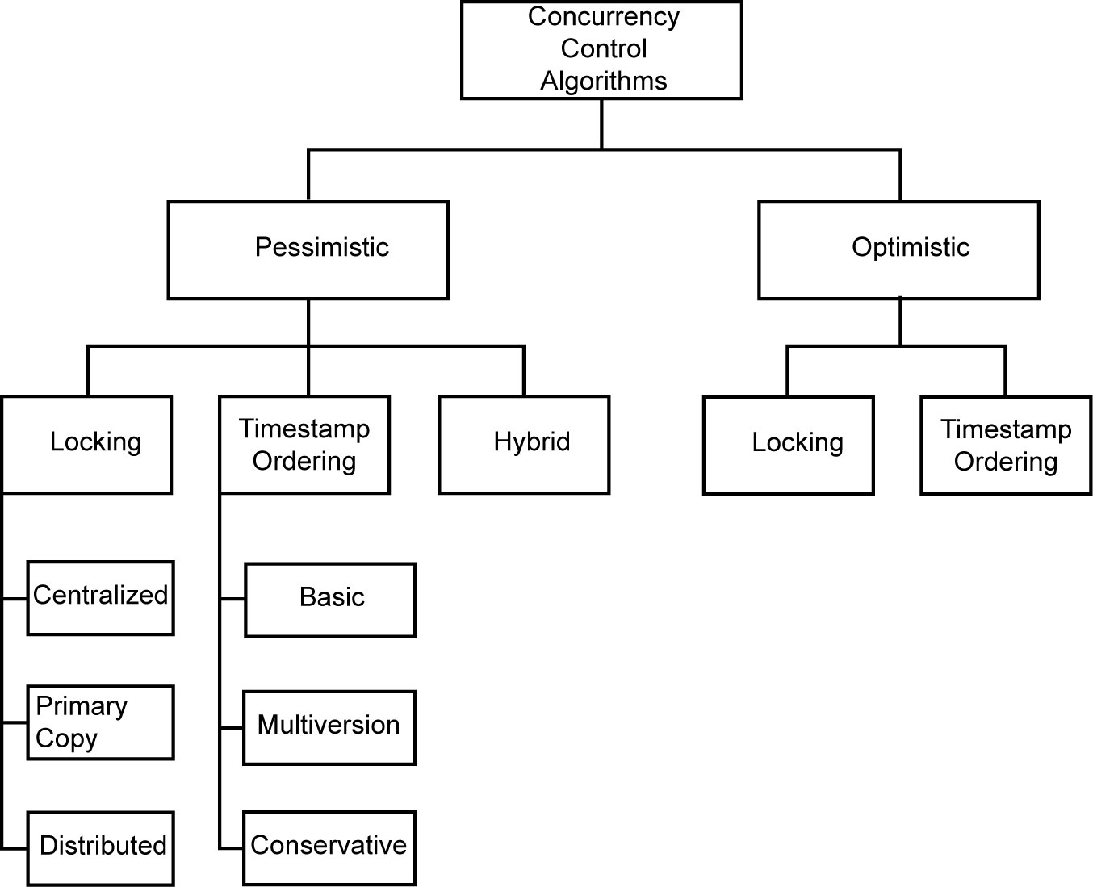
Taxonomy of concurrency control mechanism
Classification
based on synchronization primitives
locking vs. timestamp vs. hybrid
pessimistic vs. optimistic
We consider locking-based algorithm in the pessimistic scenario

Slide 17
Locking-Based Algorithms
Goal: to generate serializable histories
Transactions indicate their intentions to read/write data item x by requesting suitable locks from the scheduler (called lock manager)
Locks are either read lock (rl) [also called shared lock] or write lock (wl) [also called exclusive lock]
Read locks and write locks conflict (because so do Read and Write operations)
rl wl
rl no yes
wl yes yes
Locking works nicely to allow concurrent processing of transactions

Slide 18
Locking-Based Mechanism
TM handles R/W requests coming from applications and passes them to SC (op. type R/W, transaction id., data unit)
SC decides when to grant the lock according to compatibility access rules
When SC grants lock, the DP executes the operation (R/W)
SC is asked to release the lock
TM is informed of successful operation
Locking mechanism does not guarantee serializability (serial/serializable histories)
2-phase locking (2PL) is the solution
Begin_transaction,
Read, Write,
Commit, Abort
Results
Distributed
Execution Monitor
Transaction Manager
With other
(TM)
With other
TMs
Scheduling/
Descheduling
Requests
SCs
Scheduler
(SC)
To data
processor (DP)

Slide 19
Locking-Based Mechanism - Example
T₁: R₁(x) x ←x+1 W₁(x) R₁(y) y ←y-1 W₁(y) C₁
T₂: R₂(x) x ←x*2 W₂(x) R₂(y) y ←y*2 W₂(y) C₂
Expected results (starting with x=50, y = 20)
x=102 and y = 38 (T₁ before T₂)
x=101 and y = 39 (T₂ before T₁)
Actual results
x=102 and y = 39 (T₁ and T₂ interleave)
(simple) locking grants exclusive access to data item…
… but it does not grant isolation (T₁ and T₂ interleave)
T₁ = { R₁(x) ≺ W₁(x), R₁(y) ≺ W₁(y) }
T₁ = { R₂(x) ≺ W₂(x), R₂(y) ≺ W₂(y) }
H = { R₁(x) ≺ W₁(x) ≺ R₂(x) ≺ W₂(x) ≺ R₂(y) ≺ W₂(y) ≺ R₁(y) ≺ W₁(y) }
wl₁(x)
wl₂(x)
wl₂(y)
wl₁(y)

Slide 20
Two-Phase Locking (2PL)
A Transaction locks an object before using it
When an object is locked by another transaction, the requesting transaction must wait (if conflicting)
When a transaction releases a lock, it may not request another lock.
Lock point
Obtain lock
2PL guarantees serializable histories
Implementation issues
TM must know not only when data item x will not be used anymore…
… also when no more locks will be requested
Moreover, during descending phase other transactions get lock (dirty read)
Possibility of cascade aborts
Release lock
No. of locks
Phase 1
Phase 2
BEGIN
END

Slide 21
Strict 2PL
Strict 2PL: all locks are released together after commit
Higher degree of isolation
Easier to implement
Less concurrency
Hold locks until the end.
Obtain lock
No. of locks
Release lock
BEGIN
END
Transaction
duration
period of
data item
use
Locking-based mechanisms can cause deadlocks

Slide 22
2PL: Implementation Alternatives
Two possible implementation for (strict) 2PL in the distributed context
centralized: 1 SC
distributed: many SC

Slide 23
Centralized 2PL
There is only one 2PL scheduler in the distributed system
Lock requests are issued to the central scheduler
Coordinating TM is where the query is initiated
Data Processors at
participating sites
Coordinating TM
Central Site LM
Lock Request
Issues with centralized 2PL
Bottleneck at central LM for high workload at central LM
Low reliability in case of failure of central LM
Lock Granted
Operation
End of Operation
Release Locks

Slide 24
Distributed 2PL
2PL schedulers (LM’s) are placed at each site
each scheduler handles lock requests for data at that site
Coordinating TM
Participating LMs
Participating DPs
Lock Request
Operation
End of Operation
Release Locks

Slide 25
Deadlock
T₁ has write lock on x T₂ has write lock on y T₁ asks for write access to y T₂ asks for write access to x
Deadlock!!!
Deadlock are modeled through wait-for graph (WFG)
If transaction T_{i} waits for another transaction T_{j} to release a lock on an entity, then T_{i} → T_{j} in WFG
In distributed context the WFG is distributed across nodes
LWFG: a local graph at each site
GWFG: union of all LWFG
T_{i}
T_{j}

Slide 26
Deadlock Management
Prevention (deadlock is avoided before transaction is started)
Guaranteeing that deadlocks can never occur in the first place
do not allow for risky transactions
e.g., a transaction starts if none of data is going to use is locked
Avoidance (deadlock is avoided when a locked resource is requested)
Detecting potential deadlocks in advance and taking action to insure that deadlock will not occur. Requires run time support
Timestamps to prioritize transactions
Ordered resources
Detection and Recovery
Allowing deadlocks to form and then finding and breaking them. As in the avoidance scheme, this requires run time support.

Slide 27
Local versus Global WFG
Assume T₁ and T₂ run at site 1, T₃ and T₄ run at site 2. Also assume T₃ waits for a lock held by T₄ which waits for a lock held by T₁ which waits for a lock held by T₂ which, in turn, waits for a lock held by T₃.
Local WFG
Site 1
Site 2
T₁
T₄
T₂
T₃
Global WFG
T₁
T₄
T₂
T₃

Slide 28
Deadlock Detection
Transactions are allowed to wait freely
Wait-for graphs and cycles
Topologies for deadlock detection algorithms
Centralized
Distributed
Hierarchical

Slide 29
Centralized Deadlock Detection
One site is designated as the deadlock detector for the system. Each scheduler periodically sends its local WFG to the central site which merges them to a global WFG to determine cycles.
How often to transmit?
Too often ⇒ higher communication cost but lower delays due to undetected deadlocks
Too late ⇒ higher delays due to deadlocks, but lower communication cost
Would be a reasonable choice if the concurrency control algorithm is also centralized (centralized 2PL)

Slide 30
Hierarchical Deadlock Detection
Each site has a DD
DD are arranged in a hierarchy (e.g., tree shaped)
Each DD search for cycle in its and lower-level LWFG
Each DD sends its LWFG to upper levels
PRO: less dependence from central DD
less communication costs
CONTRO: implementation issues
DD₀
Site 7
DD₁₁
Site 5
Site 6
DD₁₂
Site 1
Site 2
Site 3
Site 4
DD₂₁
DD₂₂
DD₂₃
DD₂₄

Slide 31
Distributed Deadlock Detection
Each site has a DD that maintain an LWFG
Sites cooperate in detection of global deadlocks
One example:
The local WFGs are formed at each site and passed on to other sites. Each local WFG is modified as follows:
Since each site receives the potential deadlock cycles from other sites, these edges are added to the local WFGs
The edges in the local WFG which show that local transactions are waiting for transactions at other sites are joined with edges in the local WFGs which show that remote transactions are waiting for local ones
Each local deadlock detector:
looks for a cycle that does not involve the external edge. If it exists, there is a local deadlock which can be handled locally
looks for a cycle involving the external edge. If it exists, it indicates a potential global deadlock. Pass on the information to the next site

