Slide 1
Distributed DB architectures: An Introduction
Dario Della Monica
These slides are a modified version of the slides provided with the book
Özsu and Valduriez, Principles of Distributed Database Systems (3rd Ed.), 2011
The original version of the slides is available at: extras.springer.com

Slide 2
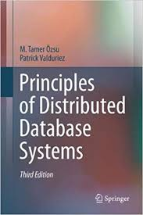
Outline (distributed DB)
Introduction (Ch. 1) ⋆
  What is a distributed DBMS
  Distributed DBMS Architecture
Distributed Database Design (Ch. 3) ⋆
Distributed Query Processing (Ch. 6-8) ⋆
Distributed Transaction Management
(Ch. 10-12) ⋆
⋆ Özsu and Valduriez,
Principles of Distributed Database Systems,
3rd edition, 2011

Slide 3
Outline (today)
Introduction (Ch. 1) ⋆
  Introduction to distributed processing
  What is (not) a Distributed Database System (DDBS)
  Data delivery alternatives
  Promises of DDBS
    Transparency
    Reliability (introduction to the problem of distributed transactions)
    Improved performances
    Easier system expansion
  Design issues
  Classification of distributed data management systems (information systems)
    Dimensions of the classification (autonomy, distribution, heterogeneity)
    Different distributed data management architectures
⋆ Özsu and Valduriez, Principles of Distributed Database Systems (3rd Ed.), 2011

Slide 4
Centralization, distribution, integration
Database philosophy
  Separation between application logic and data
  Centralization (integration) of data
  Transparency, data independence, access control
Computer network
  Distributed applications
  Distribution of data (big data)
  Concurrency, redundancy (backup), localization/proximity
Distributed databases
  Centralization data is logical
  Distribution of data is physical
  Integration

Slide 5
File Systems
program 1
File 1
data description 1
program 2
data description 2
File 2
program 3
data description 3
File 3

Slide 6
Database Management
Application
program 1
(with data
semantics)
DBMS
description
Application
program 2
(with data
semantics)
manipulation
database
control
Application
program 3
(with data
semantics)

Slide 7
Motivation
Database
Technology
Computer
Networks
logical
centralization
physical
distribution
Distributed
Database
Systems
integration
integration ≠ centralization

Slide 8
Distributed Computing
Some forms of distributed processing are everywhere (CPU vs. I/O, parallel computation, multi-processor, multi-core)
Definition (distributed computing). A number of autonomous processing elements (not necessarily homogeneous) that are interconnected by a computer network and that cooperate in performing their assigned tasks

Slide 9
Distribution: what and why?
What is being distributed?
  Processing logic (processing elements, processing devices)
  Function (tasks that are specific to a piece of hardware or software)
  Data
  Control (supervision, management of tasks)
Why to distribute?
  Widely distributed (physically) enterprises
  Reliability
  More responsive systems
  More importantly: nowadays applications are intrinsically distributed and so is the data (web-based, e-commerce, social)
  In one word (actually two): big data → divide-et-impera (divide-and-conquer)
distr. DB systems : distr. processing = DB systems : centr. processing

Slide 10
What is a Distributed Database System?
A distributed database (DDB) is a collection of multiple, logically interrelated databases distributed over a computer network.
A distributed database management system (D–DBMS) is the software that manages the DDB and provides an access mechanism that makes this distribution transparent to the users.
Distributed database system (DDBS) = DDB + D–DBMS

Slide 11
What is not a DDBS?
Files distributed over a network (missing structure and common logical access interface) → logical interrelation is missing
A number of related DB that reside on the same system → physical distribution is missing (not necessarily over a wide area, network communication)
A loosely coupled multiprocessor system → even though communication issues are similar to the one over network (no disk or memory shared), they are not enough heterogeneous (identical processors and OS’s)
  these are rather parallel DB systems
A database system which resides at one of the nodes of a network of computers – this is a centralized database on a network node → multiple DB
  these are rather client/server DB systems

Slide 12
Centralized DBMS on a Network
Site 1
Site 2
Site 5
Communication
Network
Site 4
Site 3

Slide 13
Distributed DBMS Environment
Site 1
Site 2
Site 5
Communication
Network
Site 4
Site 3

Slide 14
Implicit Assumptions
Data stored at a number of sites → each site logically consists of a single processor
Processors at different sites are interconnected by a computer network → not a multiprocessor system
  Parallel database systems
Distributed database is a database, not a collection of files → data logically related as exhibited in the users’ access patterns
  Relational data model
D-DBMS is a full-fledged DBMS
  Not remote file system, not a TP system

Slide 15
Data Delivery Alternatives
Delivery modes
  Pull-only
  Push-only
  Hybrid
Frequency
  Periodic
  Conditional
  Ad-hoc or irregular
Communication Methods
  Unicast
  One-to-many
Note: not all combinations make sense
We focus on pull-only, ad-hoc, unicast communication

Slide 16
Distributed DBMS Promises
Transparent management of distributed, fragmented, and replicated data
Improved reliability/availability through distributed transactions (distributed transactions implement protocols for, e.g., distributed concurrent access and tolerance to network communication failure)
Improved performance
Easier and more economical system expansion

Slide 17
Transparency
Transparency is the separation of the higher level semantics of a system from the lower level implementation issues
4 types of transparency
  Data independence (only form of transparency present also in centralized DBMS)
    logical VS. physical data independence
  Network transparency (or distribution transparency)
    location transparency
    naming transparency
  Replication transparency
  Fragmentation transparency
    horizontal fragmentation: selection
    vertical fragmentation: projection
    hybrid
Full transparency: tradeoff between ease of use for user and implementation difficulties/costs (poor manageability, poor modularity, poor message performance)

Slide 18
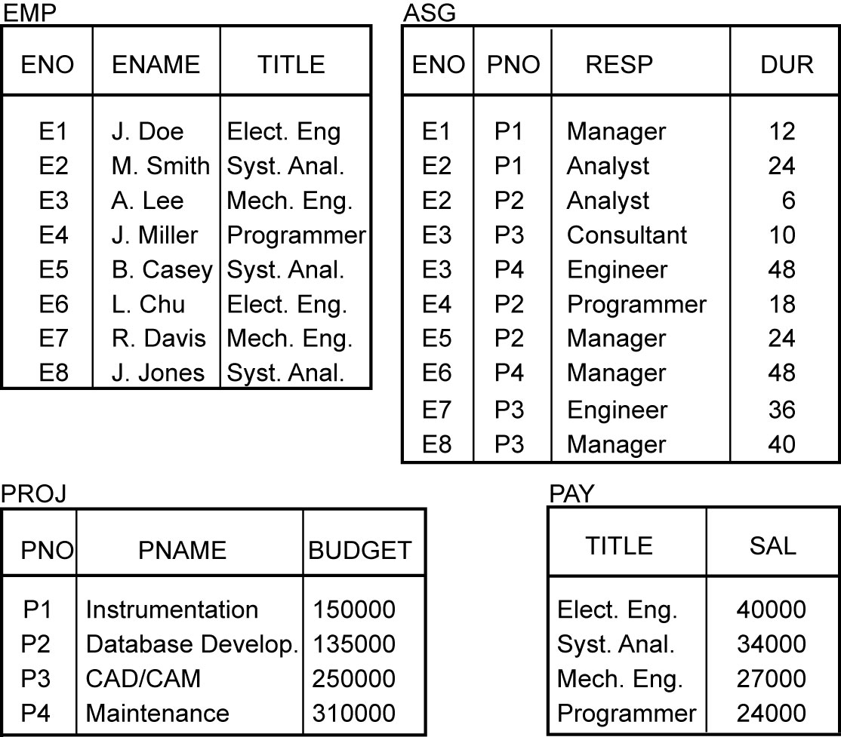
Example

Slide 19
Transparent Access
SELECT ENAME,SAL
FROM EMP,ASG,PAY
WHERE DUR > 12
AND EMP.ENO = ASG.ENO
AND PAY.TITLE = EMP.TITLE
Boston
Paris
Paris projects
Paris employees
Paris assignments
Boston employees
Communication
Network
Boston projects
Boston employees
Boston assignments
Montreal
New
York
Montreal projects
Paris projects
New York projects
with budget > 200000
Montreal employees
Montreal assignments
Boston projects
New York employees
New York projects
New York assignments
Notes:
Animated slide

Slide 20
Distributed DBMS – Reality
User
Application
DBMS
Software
DBMS
Software
DBMS
Software
Communication
Subsystem
User
Application
DBMS
Software
DBMS
Software
User
Application

Slide 21
Distributed DBMS – User View
Distributed Database

Slide 22
Reliability Through Transactions
Reliability: DB behaves as expected (consistency, availability, partition tolerance)
Replicated components and data should make distributed DBMS more reliable (no single points of failure)
(Distributed) transactions provide reliability
  bring the DB from a consistent state to another consistent one even in presence of concurrent accesses (concurrency transparency) or failures (failure atomicity)
  Distributed transaction support requires implementation of
  Distributed concurrency control protocols
  Distributed reliability protocols (commit and recovery protocols)
Data replication (we will not deal with it)
  Great for read-intensive workloads, problematic for updates
  Replication protocols

Slide 23
Potentially Improved Performance
Proximity of data to its points of use (data localization) – thanks to replication and fragmentation
  Less contention for CPU and I/O services
  Less delay related to network communication
Distributed systems improve parallelism (inter- and intra-query parallelism) – thanks to replication and fragmentation
Requires some support for fragmentation and replication (distribution of computation)

Slide 24
Easier System Expansion
Issue is database scaling
Expansion: as easy as adding a new node in the network (with its own DBMS)
  Easy thanks to transparency
Expanding a centralized DBMS is more difficult than adding a new one

Slide 25
Complications introduced by Distribution
Distributed systems are intrinsically problematic
Additional complexity of problems present in the centralized setting
Additional problems due to distribution
  Tolerance to failures of network nodes or links
  Synchronization of transactions executed on multiple sites (concurrent access)
  Replication (we will not deal with it)
    Choosing one of the stored copies
    Keep information consistent in all copies
CAP Theorem states that it is impossible for a distributed DB (where data is fragmented and replicated) to provide simultaneously:
  Consistency (always the updated data is read)
  Availability (every request receives a response)
  Partition tolerance (tolerance to network communication failures)

Slide 26
Design Issues
Distributed Database Design (Ch. 3) ⋆
  How to distribute the database (data and applications) across the sites
  (Fully/partially) Replicated & non-replicated database distribution
  Design issues: fragmentation and allocation (aka, data distribution)
  Theoretical research: mathematical investigation to solve optimization problems (e.g., minimize cost of storing, processing, and communication)
  NP-hard: thus, no exact solutions, rather solutions based on heuristics
Distributed Directory Management (Ch. 3) ⋆
  Directory contains information (e.g., location) about data
  Same issues as in Distributed Database Design
    Directory can be global (whole DB) or local (to each site)
    Centralized (at one site) or distributed (over several sites)
    Single copy or multiple copies
⋆ Özsu and Valduriez, Principles of Distributed Database Systems (3rd Ed.), 2011

Slide 27
Design Issues (2)
Distributed Query Processing (Ch. 6-8) ⋆
  Convert user transactions to data manipulation instructions
  Finding the most efficient way to execute a query over the network
    Split a global query (over global relations) into partial queries (over fragments)
  Optimization problem
    min{cost = data transmission + local processing}
  NP-hard: thus, no exact solutions, rather solutions based on heuristics
⋆ Özsu and Valduriez, Principles of Distributed Database Systems (3rd Ed.), 2011

Slide 28
Design Issues (3)
Distributed Concurrency Control (Ch. 11) ⋆
  Synchronization of concurrent accesses
  Consistency and isolation
  Locking and timestamp-based techniques
Distributed Deadlock Management (Ch. 11) ⋆
  Concurrency control mechanisms based on locking may cause deadlocks (as in OS’s)
  Prevention, avoidance, detection/recovery techniques
Reliability of Distributed DBMS (Ch. 12) ⋆
  How to make the system resilient to failures
  Atomicity and durability
Replication (Ch. 13) ⋆
  Consistency of the information (eager and lazy protocols)
⋆ Özsu and Valduriez, Principles of Distributed Database Systems (3rd Ed.), 2011

Slide 29
Relationship Among Issues
Directory
Management
Query
Processing
Distribution
Design
Reliability
Concurrency
Control
Deadlock
Management

Slide 30
Architecture
Defines the structure of the system
  components
  functions of each component
  interrelationships and interactions between components
First standard: ANSI/SPARC Architecture (70s)
Reference architectures for distributed data management
  client/server
  peer-to-peer (classic and modern) – in the terminology used in the textbook classic peer-to-peer systems correspond to Distributed DBMS we deal with in this course
  multidatabase systems (MDBS)

Slide 31
ANSI/SPARC Standard
Users
External
Schema
External
view
External
view
External
view
The world as seen by the users/applications
Conceptual
Schema
Conceptual
view
The world as seen by the enterprise/
DB designer
The world as seen by the machine
Internal
Schema
Internal view

Slide 32
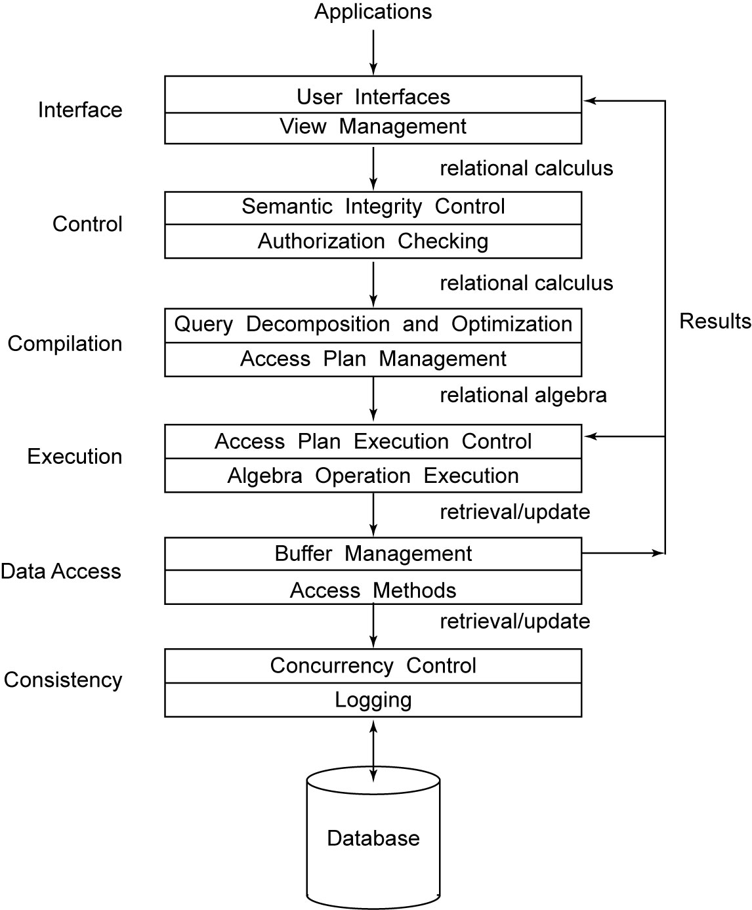
Generic DBMS Architecture

Slide 33
DDBS Data Model
...
ES₁
ES₂
ES_{n}
GCS
...
LCS₁
LCS₂
LCS_{n}
...
LIS₁
LIS₂
LIS_{n}

Slide 34
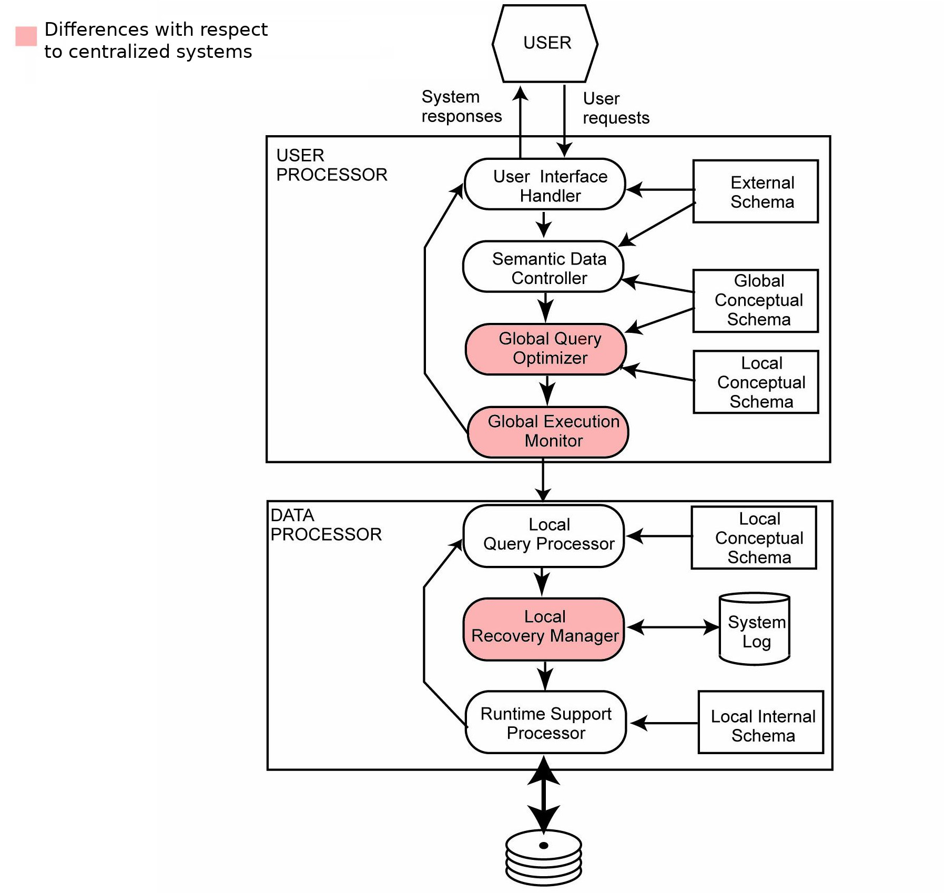
Distributed DBMS Architecture

Slide 35
A classification of data management systems
Distribution (of data and control) – non-distributed VS. client-server VS. fully distributed
  Degree of distribution of data over multiple machines (sites)
Heterogeneity – homogeneous VS. heterogeneous
  data model: different expressive power
  query language: different languages, SQL comes in different implementations
  transaction management: different protocols and policies
Autonomy (degree of synchronization) – tight integration VS. semiautonomous VS. total isolation
  Degree to which single DBMS can operate independently
    Design autonomy: ability to decide on design issues (data models, transaction management, …)
    Communication autonomy: ability to decide what information to share and how to communicate
    Execution autonomy: ability to execute transactions in any manner
  Levels of autonomy
    Tight integration (one unique logical view of the DB, data manager (DM) do not operate independently, they collaborate to execute user request)
    Semiautonomous (DM act independently, selective data sharing, common communication protocols)
    Total isolation (multidatabase systems – totally independent, unaware of each other and of communication systems, no global control, no unified DB view, each DB decides what to share with who)

Slide 36
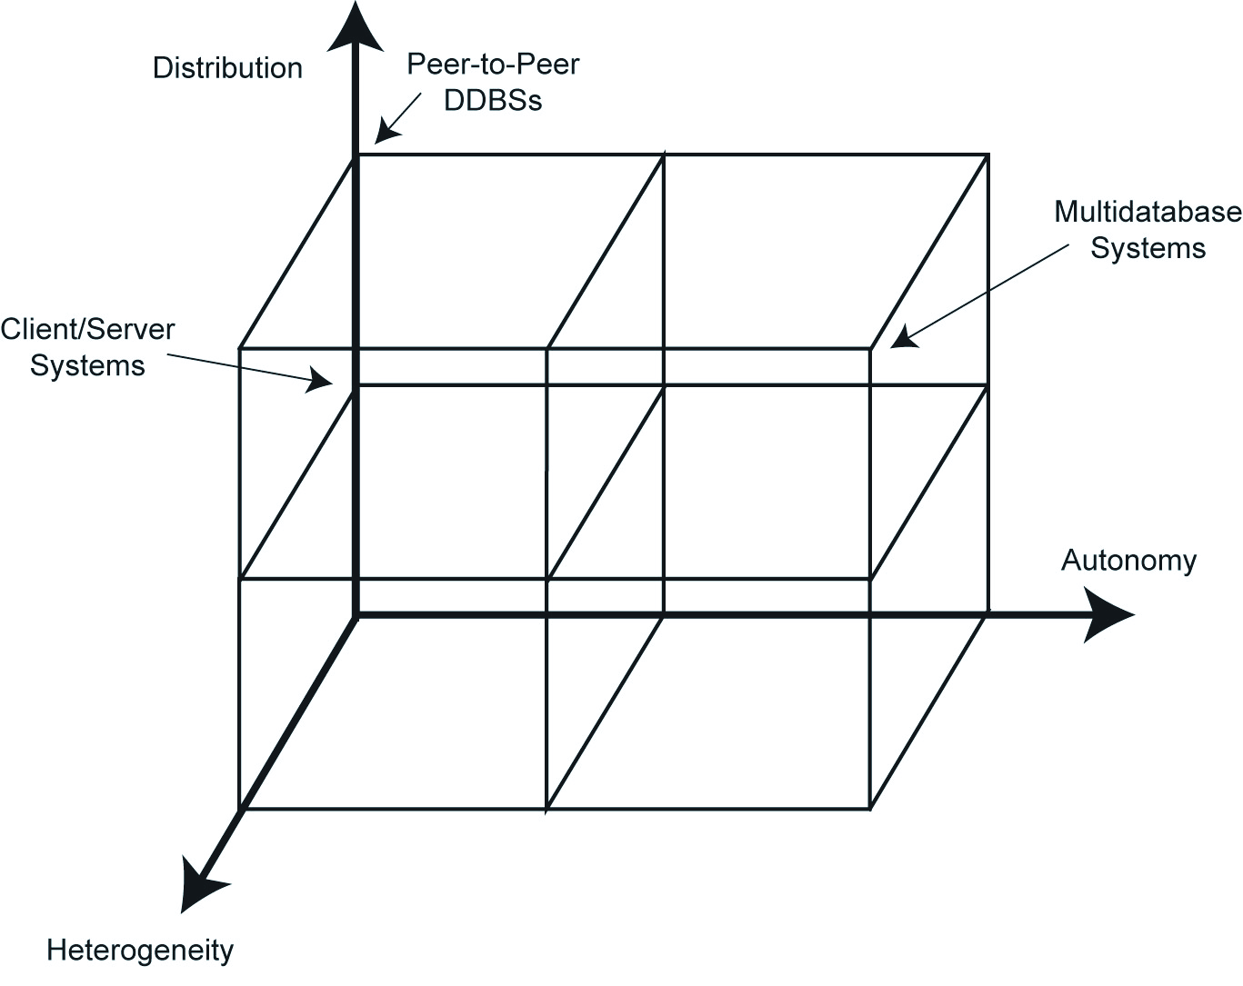
DBMS Implementation Alternatives

Slide 37
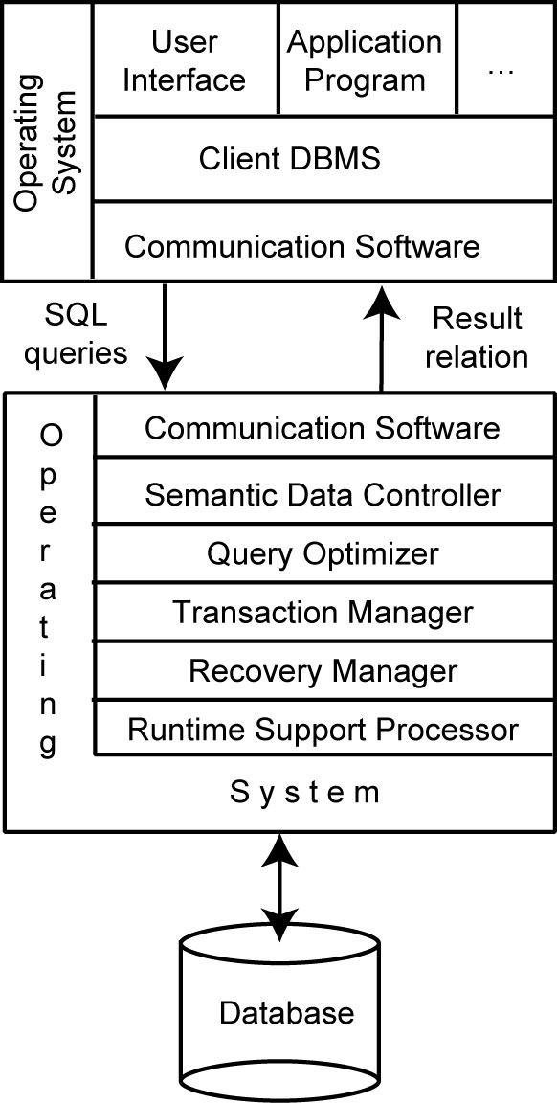
Client/Server Architecture
Nodes of the network are not identical (divided into two groups: clients and servers)
DBMS is on server(s) only
Most of the work is done by server(s)
On clients: only user interface and a DBMS client for sending queries and receiving/displaying/caching results (possibly caching transaction locks)
Not fully distributed
  multiple client/single server: like centralized DBMS (no distribution-related issues)
  multiple client/multiple servers: data and control are distributed among few servers (mild form of distribution)
Our discussion mainly refers to fully distributed DBMS, but often applies to client/server architectures

Slide 38
Multidatabase system architecture
Multidatabase system (MDBS) are beyond the scope of this course
In a nutshell
  Characterized by presence of several fully autonomous, independent, and heterogeneous DBMS that are located apart from each other
  Unaware of each other existence
  Systems do not know how to communicate with other ones
  No (explicit) interrelation between DBMS
  Each DBMS provides an export schema to make (some of) its data available to (some of) the other systems
  Control and coordination is implemented by a multidatabase layer which uses such export schema and provide interface (transparency) to the users
  In DDBS: unique conceptual view of the entire DB (GCS, providing transparency) results from the “union“ local conceptual schemas (LCS) of parts of DB stored locally at each node of the network
  In MDBS: not even a clear notion of “entire DB”
  Architecture design is built bottom-up, from LCS to a GCS (in DDBS it is built top-down, opposite direction)
If interested, see the discussions at Ch. 1.10, 4, 9 ⋆
⋆ Özsu and Valduriez, Principles of Distributed Database Systems (3rd Ed.), 2011

Slide 39
MDBS Components & Execution
Global
User
Request
Local
User
Request
Local
User
Request
Multi-DBMS
Layer
Global
Subrequest
Global
Subrequest
Global
Subrequest
DBMS₁
DBMS₂
DBMS₃

Slide 40
Recent Developments
So far, and in the rest of the course: focus on “traditional” DDBS
Recent directions
  Multidatabase systems, aka federated databases, aka data integration systems – not in this course (Ch. 1.7.10, 4, 9) ⋆
    Heterogeneity of data source
  Peer-to-peer “reloaded” and web data management – not in this course (Ch. 16, 17 ) ⋆
    Rethinking of an old architecture, oriented to needs of data sharing over the web
  Parallel databases – not in this course (Ch. 14 ) ⋆
    Specific issues (not really distributed)
⋆ Özsu and Valduriez, Principles of Distributed Database Systems (3rd Ed.), 2011

Slide 41
Terminology disambiguation
In our discussion, by distributed DBMS and DDBS we mostly refer to fully distributed, peer-to-peer data management systems
In particular, the term “peer-to-peer” (like many terms, e.g., client/server, …) is overloaded in the book and in the literature. It is used to refer to:
  ”traditional” peer-to-peer DBMS (also referred to as fully distributed DBMS) → our focus is on these systems
  “modern” peer-to-peer data management systems [we refer to this meaning in the slide titled “Recent developments”]
    These refer to an evolution of the traditional peer-to-peer architecture, to cope with the need of data sharing, e.g., over the web
    Ongoing research area, related issues still being investigated
    Out of the scope of this course (see Ch. 16) ⋆
⋆ Özsu and Valduriez, Principles of Distributed Database Systems (3rd Ed.), 2011

