Slide 1
Distributed DB architectures: An Introduction
Data Management for Big Data
2018-2019 (spring semester)
Dario Della Monica
These slides are a modified version of the slides provided with the book
Özsu and Valduriez, Principles of Distributed Database Systems (3rd Ed.), 2011
The original version of the slides is available at: extras.springer.com

Slide 2
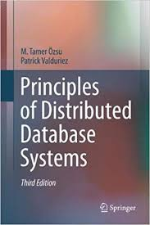
Outline (distributed DB)
Introduction (Ch. 1) ⋆
  What is a distributed DBMS
  Distributed DBMS Architecture
Distributed Database Design (Ch. 3) ⋆
Distributed Query Processing (Ch. 6-8) ⋆
Distributed Transaction Management
(Ch. 10-12) ⋆
⋆ Özsu and Valduriez,
Principles of Distributed Database Systems,
3rd edition, 2011

Slide 3
Outline (today)
Introduction (Ch. 1) ⋆
  Introduction to distributed processing
  What is (not) a Distributed Database System (DDBS)
  Data delivery alternatives
  Promises of DDBS
    Transparency and its levels
    Reliability (introduction to the problem of distributed transactions)
    Improved performances
    Easier system expansion
  Design issues (deriving for the promises)
  Classification of Distributed DBMS (D-DBMS)
    Dimensions of the classification (autonomy, distribution, heterogeneity)
    Different D-DBMS Architectures
⋆ Özsu and Valduriez, Principles of Distributed Database Systems (3rd Ed.), 2011

Slide 4
Centralization, distribution, integration
Database philosophy
  Separation between application logic and data
  Centralization (integration) of data
  Transparency, data independence, access control
Computer network
  Distributed applications
  Distribution of data (big data)
  Concurrency, redundancy (backup), localization/proximity
Distributed databases
  Centralization data is logical
  Distribution of data is physical
  Integration

Slide 5
File Systems
program 1
File 1
data description 1
program 2
data description 2
File 2
program 3
data description 3
File 3

Slide 6
Database Management
Application
program 1
(with data
semantics)
DBMS
description
Application
program 2
(with data
semantics)
manipulation
database
control
Application
program 3
(with data
semantics)

Slide 7
Motivation
Database
Technology
Computer
Networks
logical
centralization
physical
distribution
Distributed
Database
Systems
integration
integration ≠ centralization

Slide 8
Distributed Computing
Some forms of distributed processing are everywhere (CPU vs. I/O, parallel computation, multi-processor, multi-core)
Definition (distributed computing). A number of autonomous processing elements (not necessarily homogeneous) that are interconnected by a computer network and that cooperate in performing their assigned tasks

Slide 9
Distribution: what and why?
What is being distributed?
  Processing logic (pieces of computations)
  Function (tasks that are specific to a piece of hardware or software)
  Data
  Control
Why to distribute?
  Widely distributed (physically) enterprises
  Reliability
  More responsive systems
  More importantly: nowadays applications are intrinsically distributed and so is the data (web-based, e-commerce, social)
  In one word (actually two): big data → divide-et-impera (divide-and-conquer)
distr. DB systems : distr. processing = DB systems : centr. processing

Slide 10
What is a Distributed Database System?
A distributed database (DDB) is a collection of multiple, logically interrelated databases distributed over a computer network.
A distributed database management system (D–DBMS) is the software that manages the DDB and provides an access mechanism that makes this distribution transparent to the users.
Distributed database system (DDBS) = DDB + D–DBMS

Slide 11
What is not a DDBS?
Files distributed over a network (missing structure and common logical access interface) → logical interrelation
A number of related DB that reside on the same system → physical distribution (not necessarily over a wide area, network communication)
A loosely coupled multiprocessor system → even though communication issues are similar to the one over network (no disk or memory shared), they are not enough heterogeneous (identical processors and OS’s) → parallel DB systems
A database system which resides at one of the nodes of a network of computers - this is a centralized database on a network node → multiple DB → client/server DB systems

Slide 12
Centralized DBMS on a Network
Site 1
Site 2
Site 5
Communication
Network
Site 4
Site 3

Slide 13
Distributed DBMS Environment
Site 1
Site 2
Site 5
Communication
Network
Site 4
Site 3

Slide 14
Implicit Assumptions
Data stored at a number of sites → each site logically consists of a single processor.
Processors at different sites are interconnected by a computer network → not a multiprocessor system
  Parallel database systems
Distributed database is a database, not a collection of files → data logically related as exhibited in the users’ access patterns
  Relational data model
D-DBMS is a full-fledged DBMS
  Not remote file system, not a TP system

Slide 15
Data Delivery Alternatives
Delivery modes
  Pull-only
  Push-only
  Hybrid
Frequency
  Periodic
  Conditional
  Ad-hoc or irregular
Communication Methods
  Unicast
  One-to-many
Note: not all combinations make sense

Slide 16
Distributed DBMS Promises
Transparent management of distributed, fragmented, and replicated data
Improved reliability/availability through distributed transactions (tolerance to, e.g., network communication failure and concurrent access)
Improved performance
Easier and more economical system expansion

Slide 17
Transparency
Transparency is the separation of the higher level semantics of a system from the lower level implementation issues
4 types of transparency. Fundamental issue is to provide
        data independence
in the distributed environment
  Network transparency (or distribution transparency)
    Location transparency
    Naming transparency
  Replication transparency
  Fragmentation transparency
    horizontal fragmentation: selection
    vertical fragmentation: projection
    hybrid

Slide 18
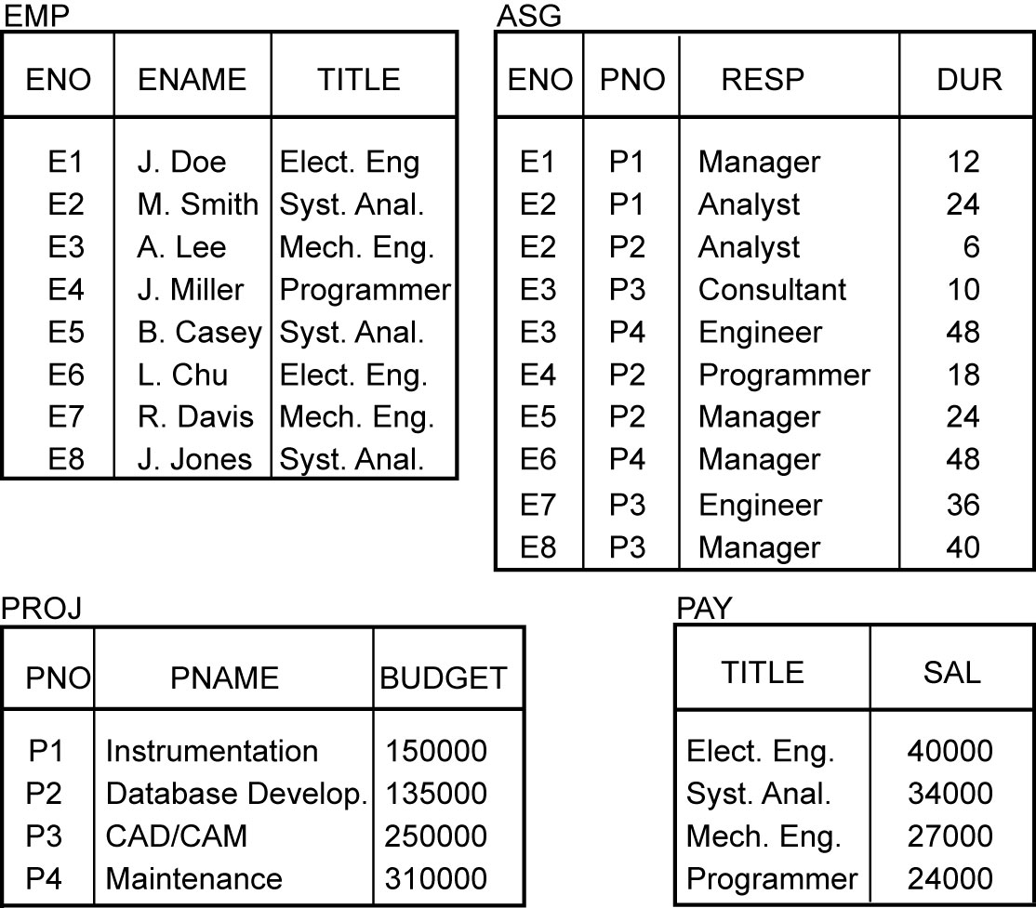
Example

Slide 19
Transparent Access
SELECT ENAME,SAL
FROM EMP,ASG,PAY
WHERE DUR > 12
AND EMP.ENO = ASG.ENO
AND PAY.TITLE = EMP.TITLE
Tokyo
Boston
Paris
Paris projects
Paris employees
Paris assignments
Boston employees
Communication
Network
Boston projects
Boston employees
Boston assignments
Montreal
New
York
Montreal projects
Paris projects
New York projects
with budget > 200000
Montreal employees
Montreal assignments
Boston projects
New York employees
New York projects
New York assignments
Notes:
Animated slide

Slide 20
Distributed Database - User View
Distributed Database

Slide 21
Distributed DBMS - Reality
User
Query
DBMS
Software
User
Application
DBMS
Software
DBMS
Software
Communication
Subsystem
User
Application
DBMS
Software
User
Query
DBMS
Software
User
Query

Slide 22
Reliability Through Transactions
Replicated components and data should make distributed DBMS more reliable
Transactions: sequences of DB operations executed as atomic actions
(Distributed) transactions provide
  Consistency: bring the DB from a consistent state to another consistent one
  Reliability: Concurrency transparency, Failure atomicity
  Distributed transaction support requires implementation of
  Distributed concurrency control protocols
  Commit protocols
Data replication (we will not deal with it)
  Great for read-intensive workloads, problematic for updates
  Replication protocols

Slide 23
Distributed systems are intrinsically problematic
CAP Theorem states that it is impossible for a distributed DB (where data is fragmented and replicated) to provide simultaneously:
Consistency (always the updated data is read)
Availability (every request receives a response)
Partition tolerance (tolerance to network communication failures)

Slide 24
Potentially Improved Performance
Proximity of data to its points of use
  Requires some support for fragmentation and replication
Parallelism in execution
  Inter-query parallelism
  Intra-query parallelism

Slide 25
Parallelism Requirements
Have as much of the data required by each application at the site where the application executes
  Full replication
How about updates?
  Mutual consistency
  Freshness of copies

Slide 26
Easier System Expansion
Issue is database scaling
Expansion: as easy as adding a new node in the network (with its own DBMS)
  Easy thanks to transparency
Expanding a centralized DBMS is more difficult than adding a new one

Slide 27
Distributed DBMS Issues
Distributed Database Design
  How to distribute the database
  Replicated & non-replicated database distribution
  A related problem in directory management
Query Processing
  Convert user transactions to data manipulation instructions
  Optimization problem
    min{cost = data transmission + local processing}
  General formulation is NP-hard

Slide 28
Distributed DBMS Issues
Concurrency Control
  Synchronization of concurrent accesses
  Consistency and isolation of transactions' effects
Distributed Deadlock management
  Prevention, avoidance, detection/recovery techniques
Reliability
  How to make the system resilient to failures
  Atomicity and durability
Replication
  Consistency of the information (eager and lazy protocols)

Slide 29
Relationship Between Issues
Directory
Management
Query
Processing
Distribution
Design
Reliability
Concurrency
Control
Deadlock
Management

Slide 30
Recent Developments
So far, and in the rest of the course: focus on “traditional” DDBS
Recent directions
  Multidatabase systems, aka federated databases, aka data integration systems - not in this course (Ch. 1.10, 4, 9) ⋆
    Heterogeneity of data source
  Peer-to-peer “reloaded” and web data management - not in this course (Ch. 16, 17 ) ⋆
    Rethinking of an old architecture, oriented to needs of data sharing over the web
  Parallel databases – maybe at the end of the course (Ch. 14 ) ⋆
    Specific issues (not really distributed)
⋆ Özsu and Valduriez, Principles of Distributed Database Systems (3rd Ed.), 2011

Slide 31
Architecture
Defines the structure of the system
  components identified
  functions of each component defined
  interrelationships and interactions between components defined

Slide 32
ANSI/SPARC Architecture
Users
External
Schema
External
view
External
view
External
view
The world as seen by the users/applications
Conceptual
Schema
Conceptual
view
The world as seen by the enterprise
The world as seen by the machine
Internal
Schema
Internal view

Slide 33
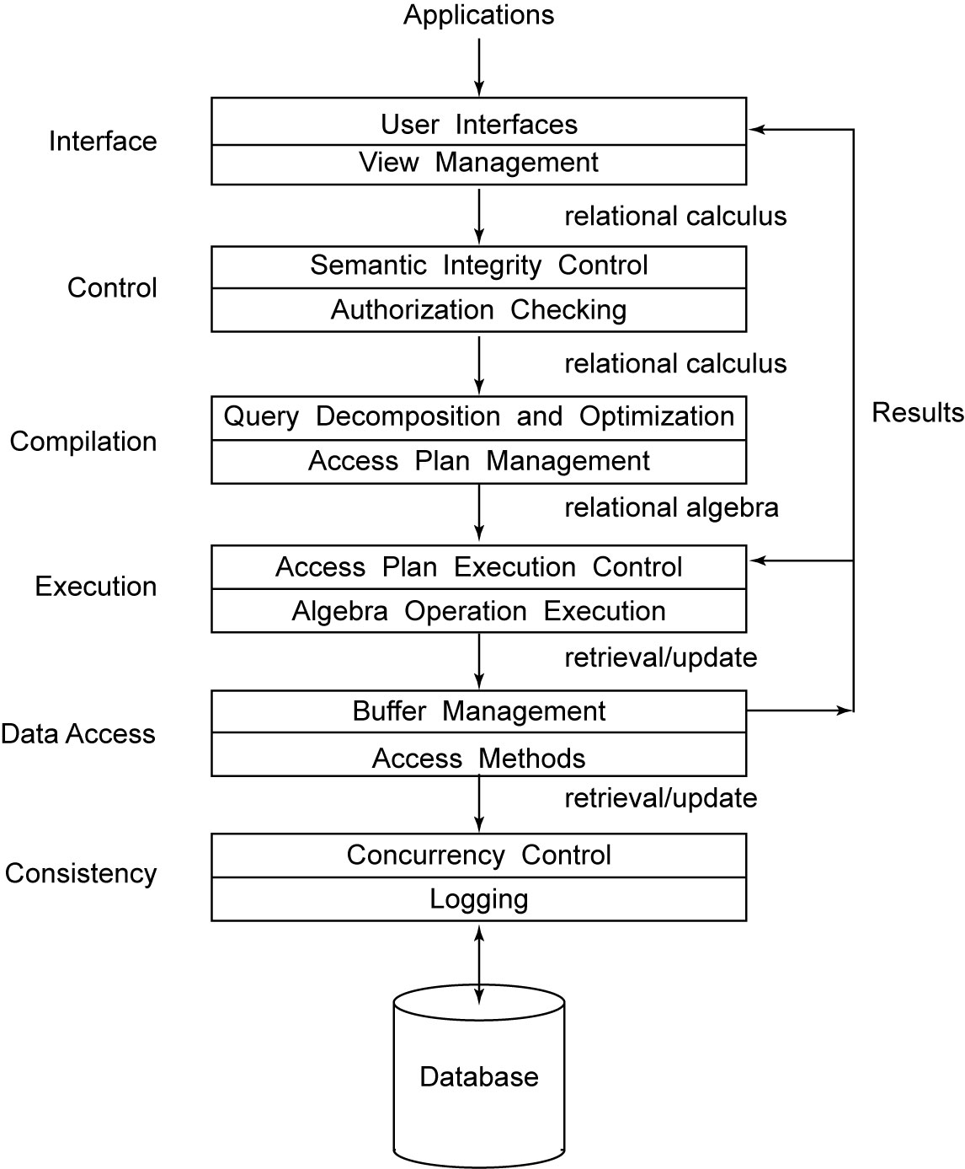
Generic DBMS Architecture

Slide 34
Dimensions of the Problem
Distribution (of data)
  Whether the components of the system are located on the same machine or not
    Non-distributed/client-server/fully distributed (peer-to-peer)
Heterogeneity
  Hardware, communications, data model, query language, transaction management
Autonomy (distribution of control)
  Various versions
    Design autonomy: ability of a component DBMS to decide on issues related to its own design.
    Communication autonomy: ability of a component DBMS to decide whether and how to communicate with other DBMSs and what information to share with them.
    Execution autonomy: ability of a component DBMS to execute transaction operations in any manner it wants to
  Classification along this dimension:
    Tight integration (one unique logical view of the DB, control is centralized for each user request)
    Semiautonomous (independent DBMS, selective data sharing, common communication protocols)
    Total isolation (multidatabase systems – totally independent, unaware of each other and of communication systems, no global control, no unified DB view, each DB decides what to share with who)

Slide 35
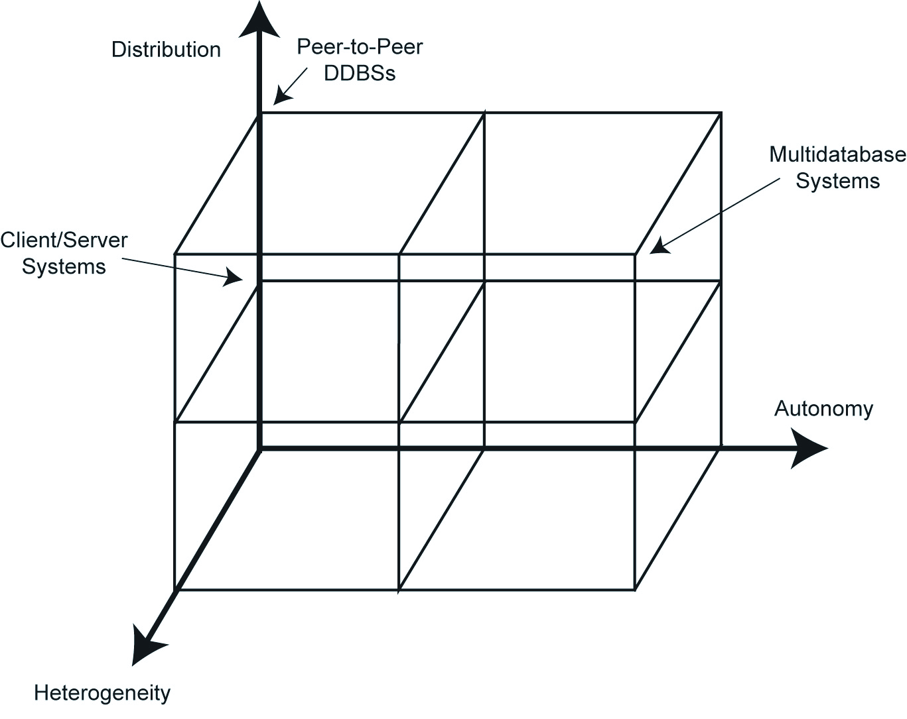
DBMS Implementation Alternatives

Slide 36
Terminology disambiguation
In our discussion, by distributed DBMS and DDBS we mostly refer to fully distributed, peer-to-peer data management systems
In particular, the term “peer-to-peer” is overloaded in the book. It is used to refer to:
  ”traditional” peer-to-peer DBMS (also referred to as fully distributed DBMS) → our focus is on these systems [see previous two slides]
  “modern” peer-to-peer data management systems [see slide slide titled “Recent developments”]
    These refer to an evolution of the traditional peer-to-peer architecture, to cope with the need of data sharing, e.g., over the web
    Ongoing research area, related issues still being investigated
    Out of the scope of this course (see Ch. 16) ⋆
⋆ Özsu and Valduriez, Principles of Distributed Database Systems (3rd Ed.), 2011

Slide 37
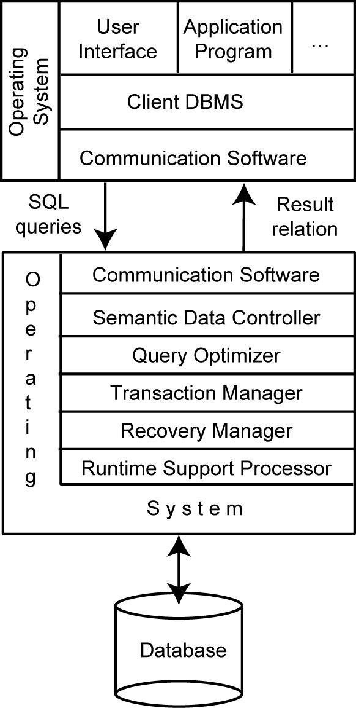
Client/Server Architecture
Not fully distributed: data and control are distributed among few servers (multiple client/multiple servers) or not distributed at all (multiple client/single server)
Nodes of the network are not identical (divided into two groups: clients and servers)
DBMS is on server(s) only
Most of the work is done by server(s)
On clients: only a DBMS client for sending queries and receiving/displaying results
Multiple client/single servers: like centralized DBMS (no distribution-related issues)
Multiple client/multiple servers: mild form of distribution
Our discussion mainly refers to fully distributed DBMS, but often applies to client/server architectures

Slide 38
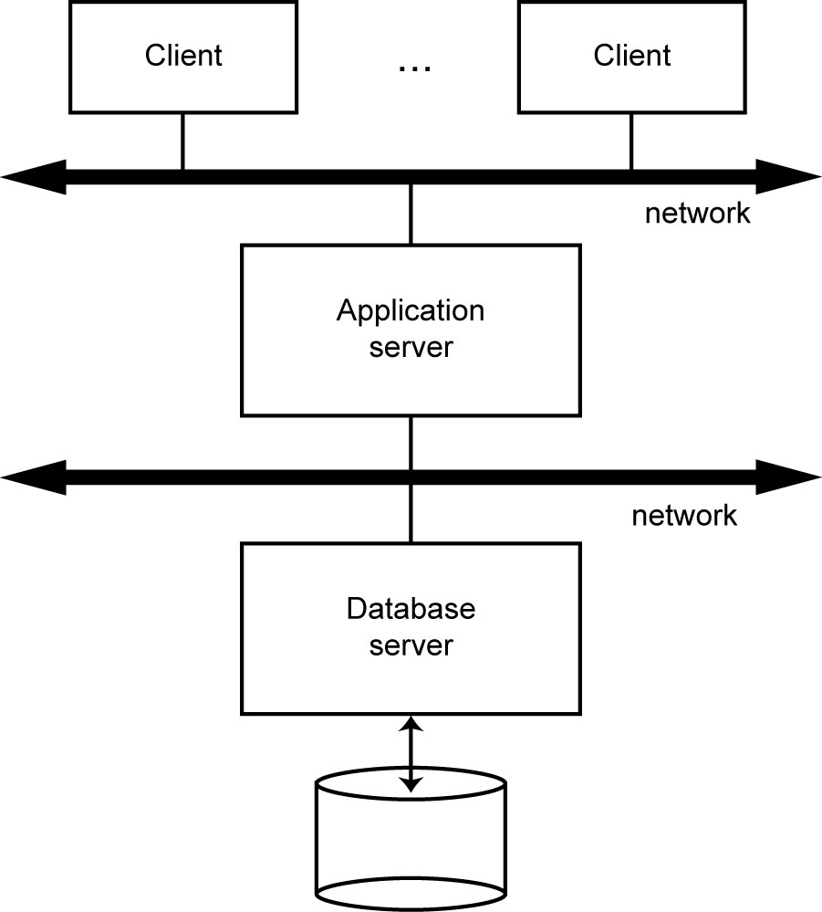
Database Server

Slide 39
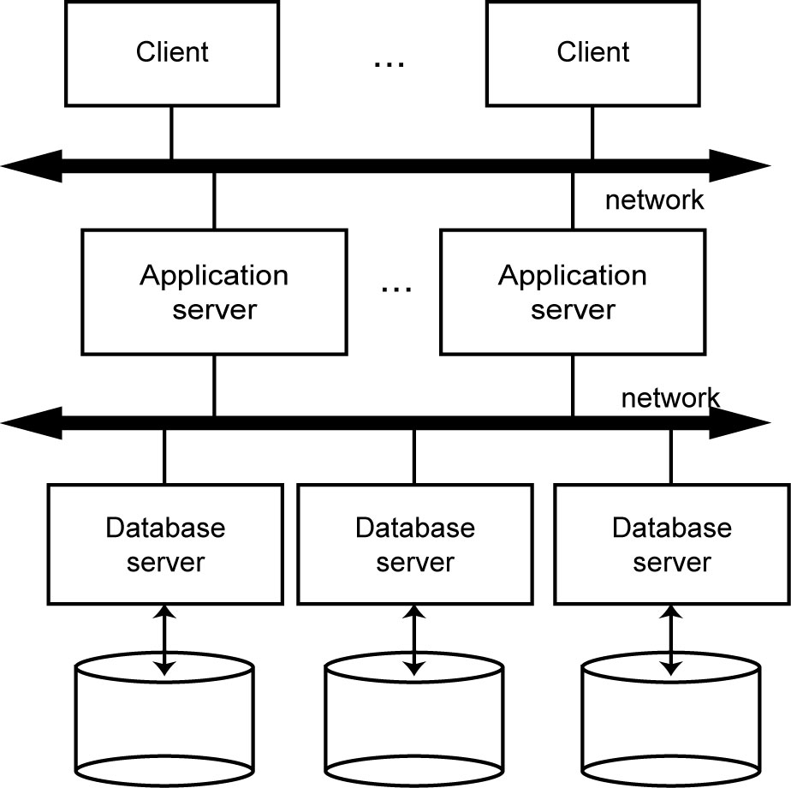
Distributed Database Servers

Slide 40
Multidatabase system architecture
Multidatabase system (MDBS) are beyond the scope of this course
In a nutshell
  Characterized by presence of several fully autonomous, independent, and heterogeneous DBMS that are located apart from each other
  Unaware of each other existence
  Systems do not know how to communicate with other ones
  No (explicit) interrelation between DBMS
  Each DBMS provides an export schema to make (some of) its data available to (some of) the other systems
  In DDBS: unique logical view of the entire DB (transparency) resulting from the “union“ of parts of DB stored locally at each node of the network
  In MDBS: not even a clear notion of “entire DB”
  Architecture design is built bottom-up (in DDBS it is built top-down)
If interested, see the discussion at Ch. 1.10, 4, 9 ⋆
⋆ Özsu and Valduriez, Principles of Distributed Database Systems (3rd Ed.), 2011

Slide 41
MDBS Components & Execution
Global
User
Request
Local
User
Request
Local
User
Request
Multi-DBMS
Layer
Global
Subrequest
Global
Subrequest
Global
Subrequest
DBMS₁
DBMS₂
DBMS₃

